Slide 1
Car Accident Severity Prediction Report
Applied Data Science Capstone
Qing Yang (Tony) Xie

Slide 2

Introduction
Travelling by car is essential for many people to reach their destinations efficiently
Car accidents can occur due to various type of circumstances
Car accidents can inflict damage to the vehicle and harm to the people involved. Specifically, it can cause economic loss, injuries and even fatalities.
The goal of this study is to develop a model that improves driver’s awareness of a dangerous condition and reduce the likelihood of a car accident.

Slide 3
Dataset Description
The data set used in this study comes from Seattle Department of Transportation, Traffic Records group.
It consists of records from 2004 to present
Original data set has:
37 attributes
194673 rows/records

Slide 4
Data Pre-processing
Target variable is severity code, which describes the severity of the collision
Original data set was pre-processed due to the following reasons:
Unbalanced data
Null entries
Duplicated attribute
Attribute data type
Selection of key attributes for analysis

Slide 5
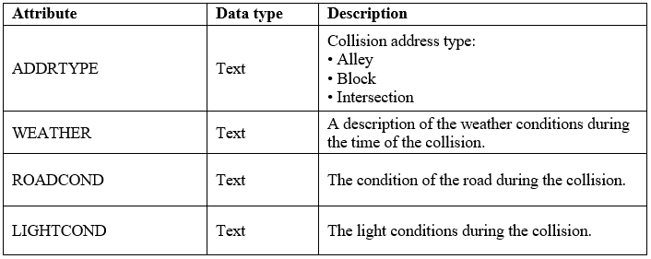
Independent Variables Selection
The following attributes are indicative of driver’s surrounding geographical and atmospheric conditions; therefore are selected as independent variables

Slide 6
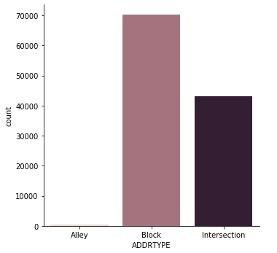
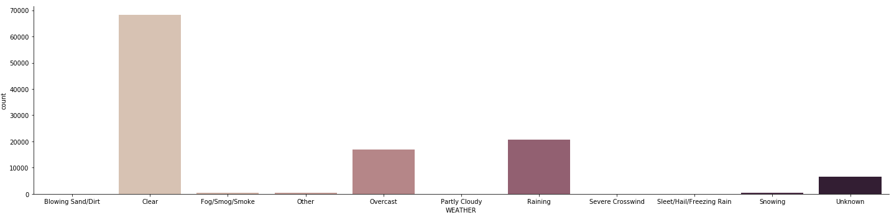
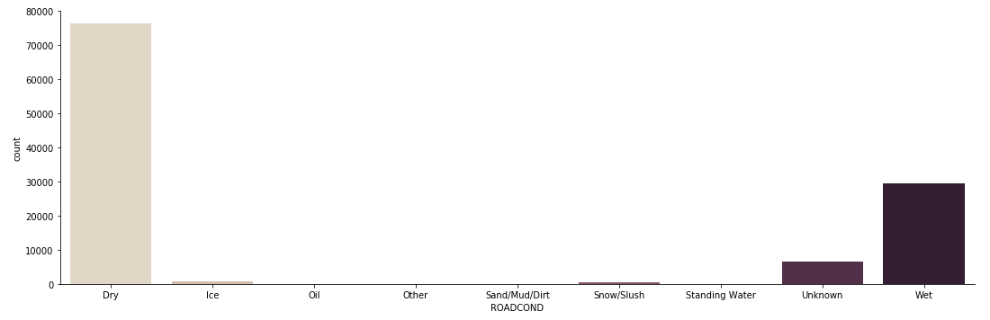
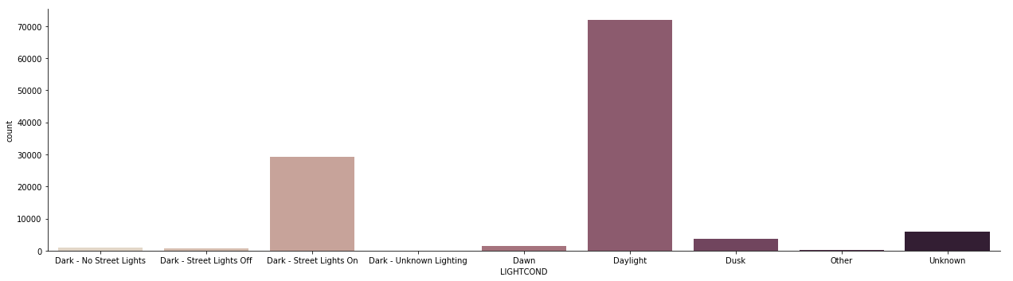
Data Exploration

Slide 7
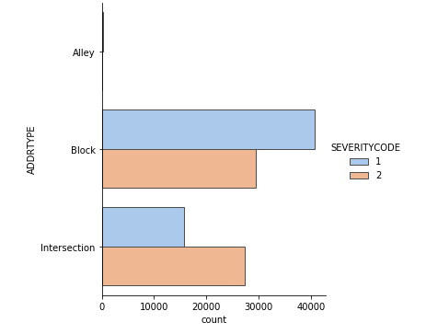
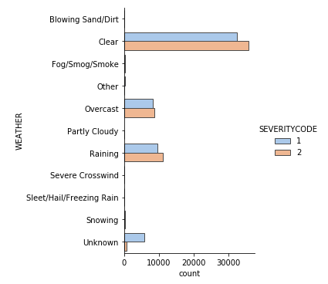
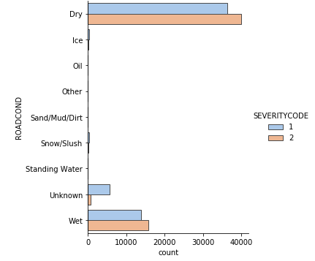
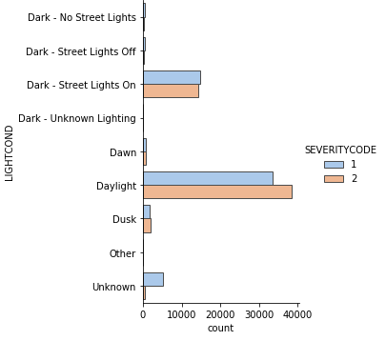
Data Exploration

Slide 8
Data Exploration
Based on the data exploration plots, the following information is observed:
There are substantially more car accident records from “Block” and “Intersection” than the “Alley”
The highest counts of accident records for weather conditions, road conditions and light conditions attributes are “Clear”, “Dry” and “Daylight”, respectively
There are several categories under each attribute that have noticeable differences between the count of severity 1 accidents and the count of severity 2 accidents

Slide 9
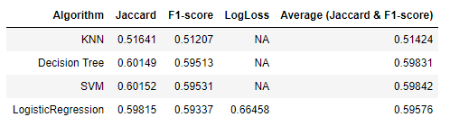
Results and Discussion
The average of Jaccard score and F1-score for Support Vector Machine model is slightly higher than the other models used in this study
Since the average of Jaccard and F1-score is close to 0.6, the model is only moderately accurate

Slide 10
Conclusion
Support Vector Machine only has moderate accuracy to predict the severity of car accident when using collision address type, weather conditions, road conditions and light conditions as the key attributes
Existing models can be further optimized by adjusting tuning parameters
Other car accident related attributes can also be explored in future studies to build models with higher accuracy

